Slide 1



FAIR Data Infrastructure for Computation
Advanced many-body methods
José M. (Chema) Pizarro
N. Daelman, J.F. Rudzinski, L.M.Ghiringhelli, R. Valentí, S. Botti, C. Draxl
jose.pizarro@physik.hu-berlin.de
@JosePizarroB (Twitter)

Slide 2
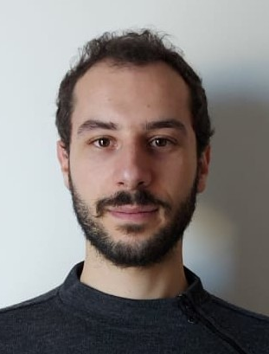
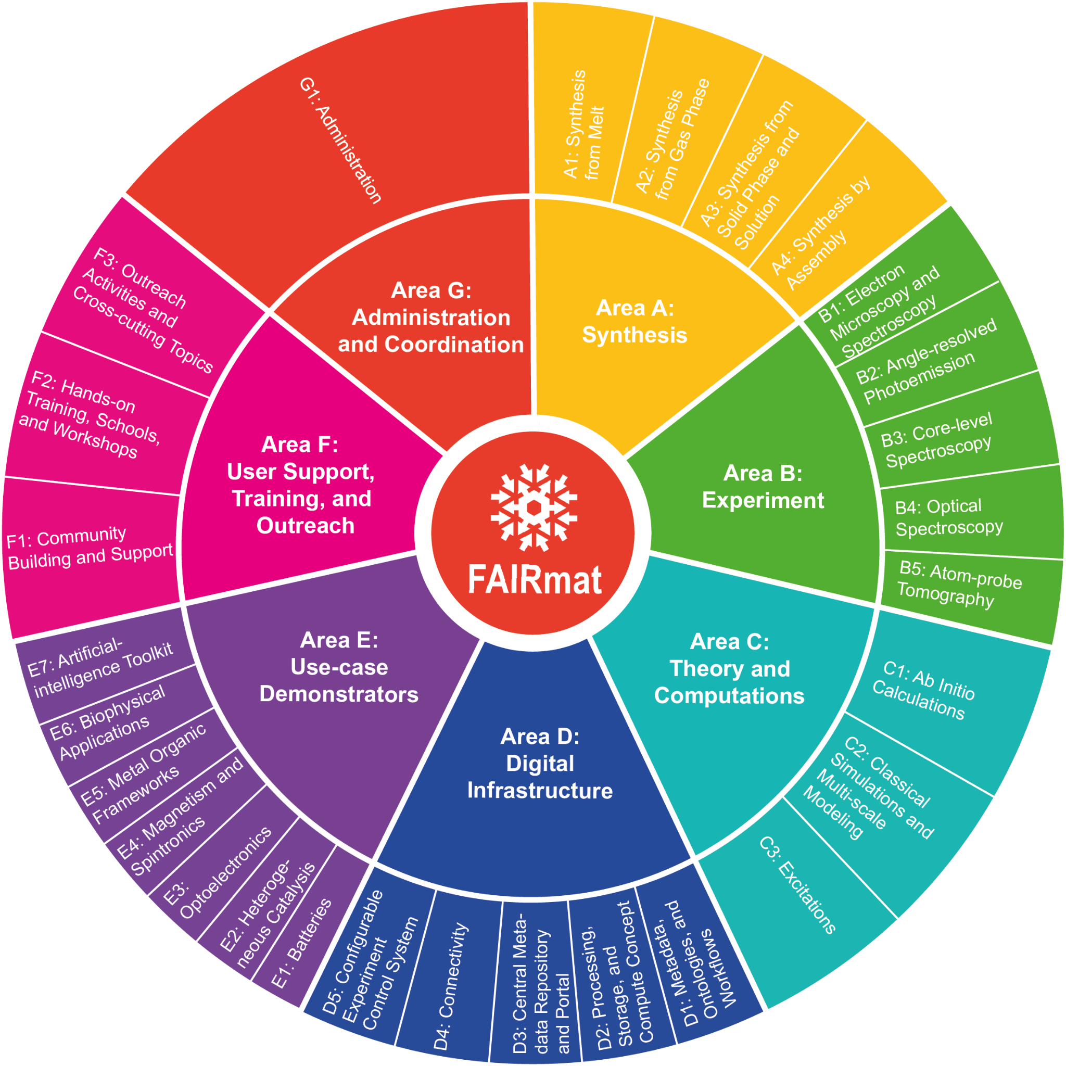



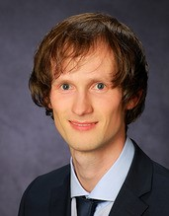

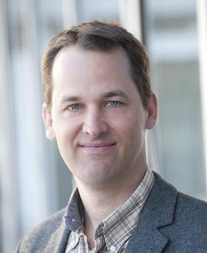
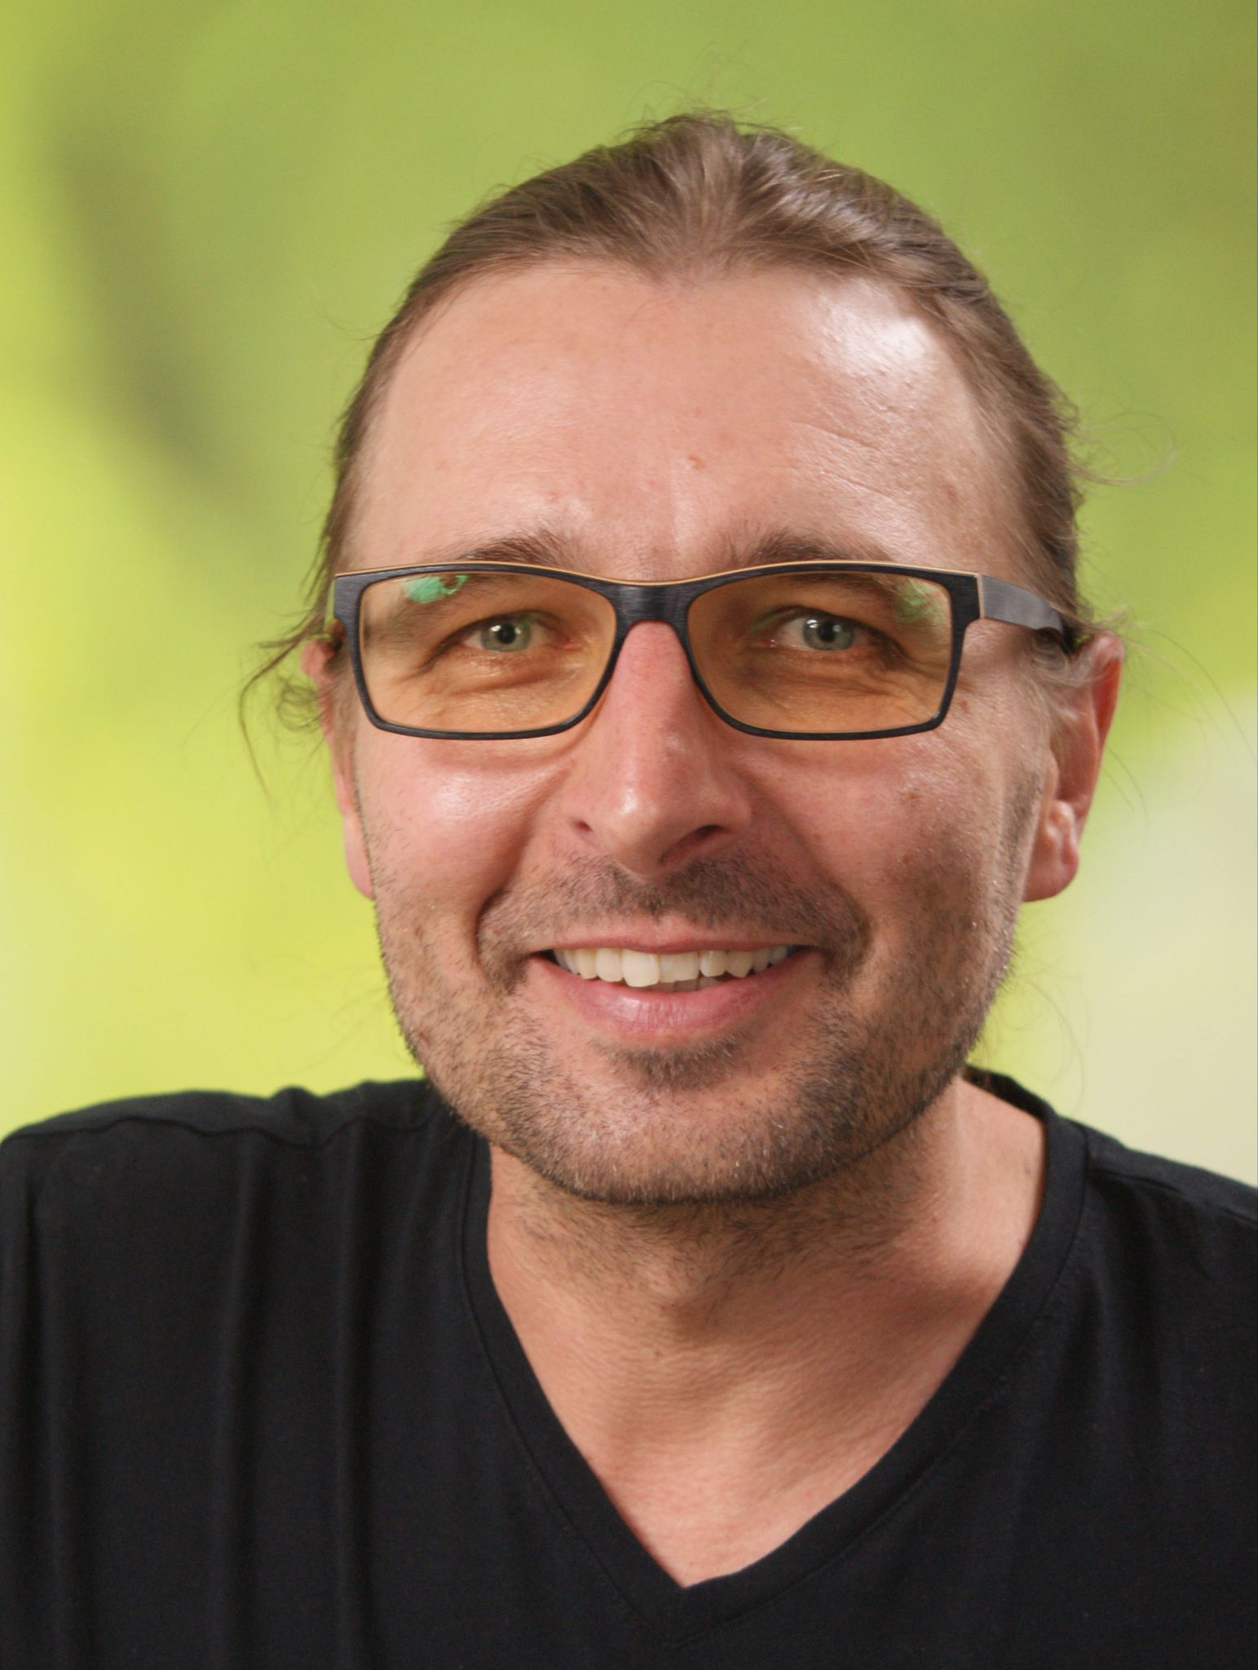


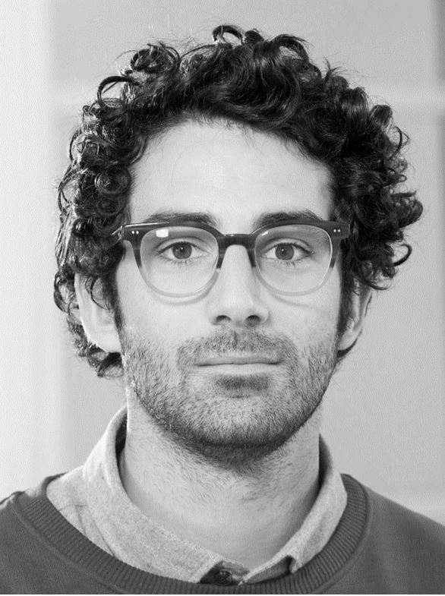

FAIR = Findable, Accessible, Interoperable, Reusable

Slide 3

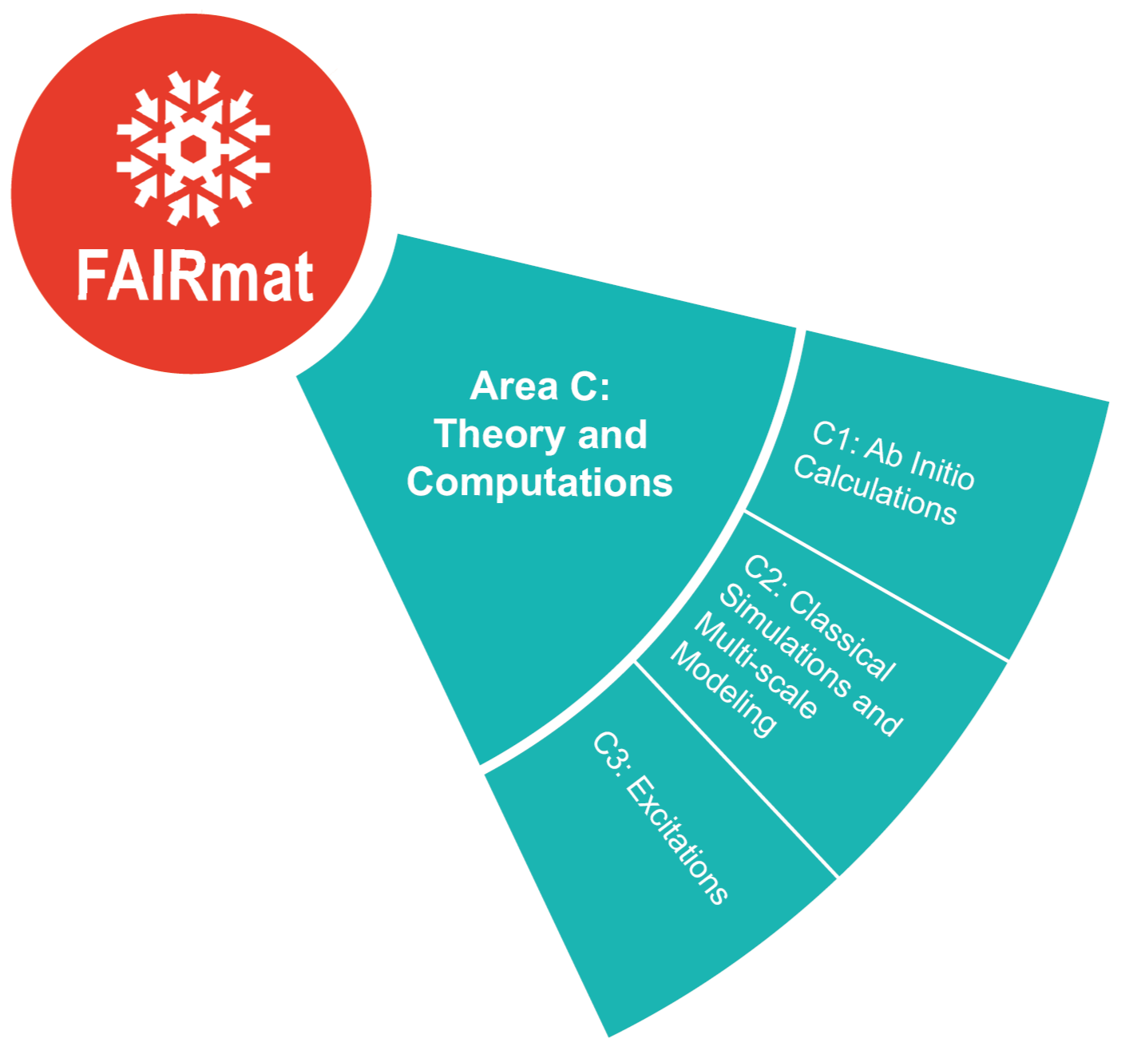
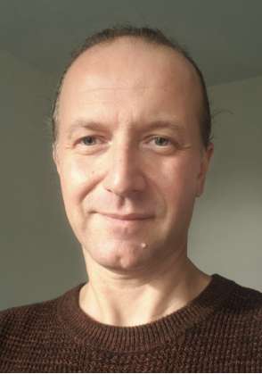
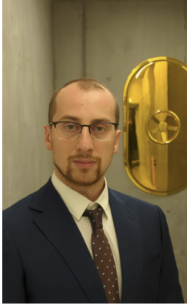
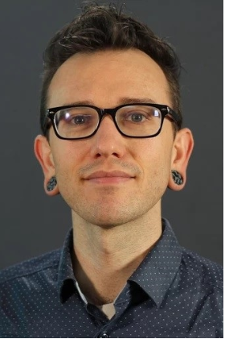
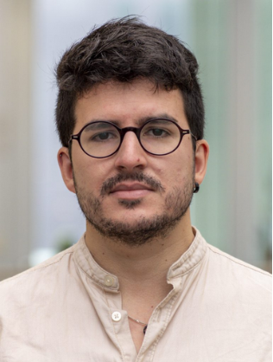

Silvana Botti
Luca M. Ghiringhelli
Nathan Daelmann
O 95.10, 12:15
Friday, 31.03.2023
Joseph F. Rudzinski
O 95.6, 11:00
Friday, 31.03.2023
+ PIs, postdocs, students…
Jonas Schwab (QMC)
O 84.9, 17:45
Thursday, 30.03.2023
Jose M. Pizarro

Slide 4
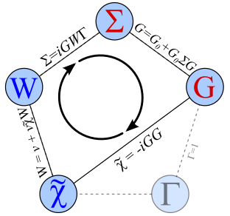
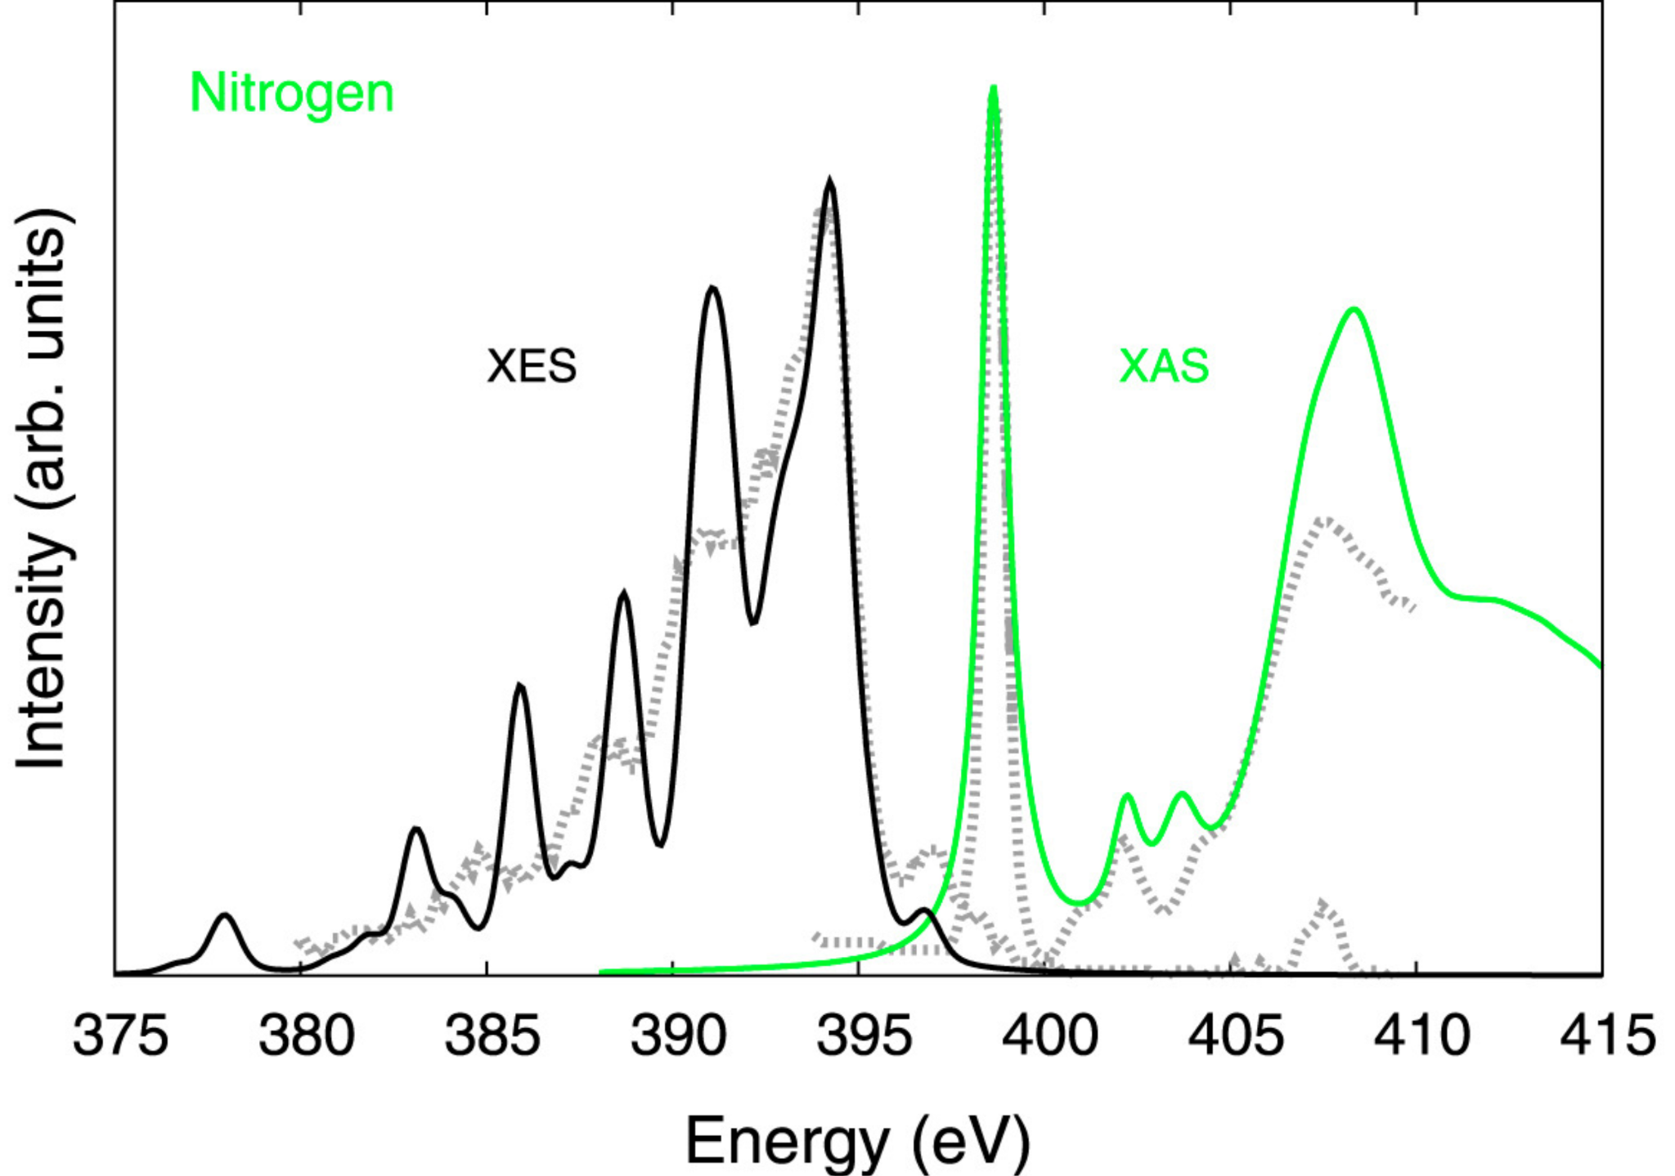
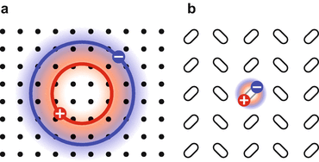
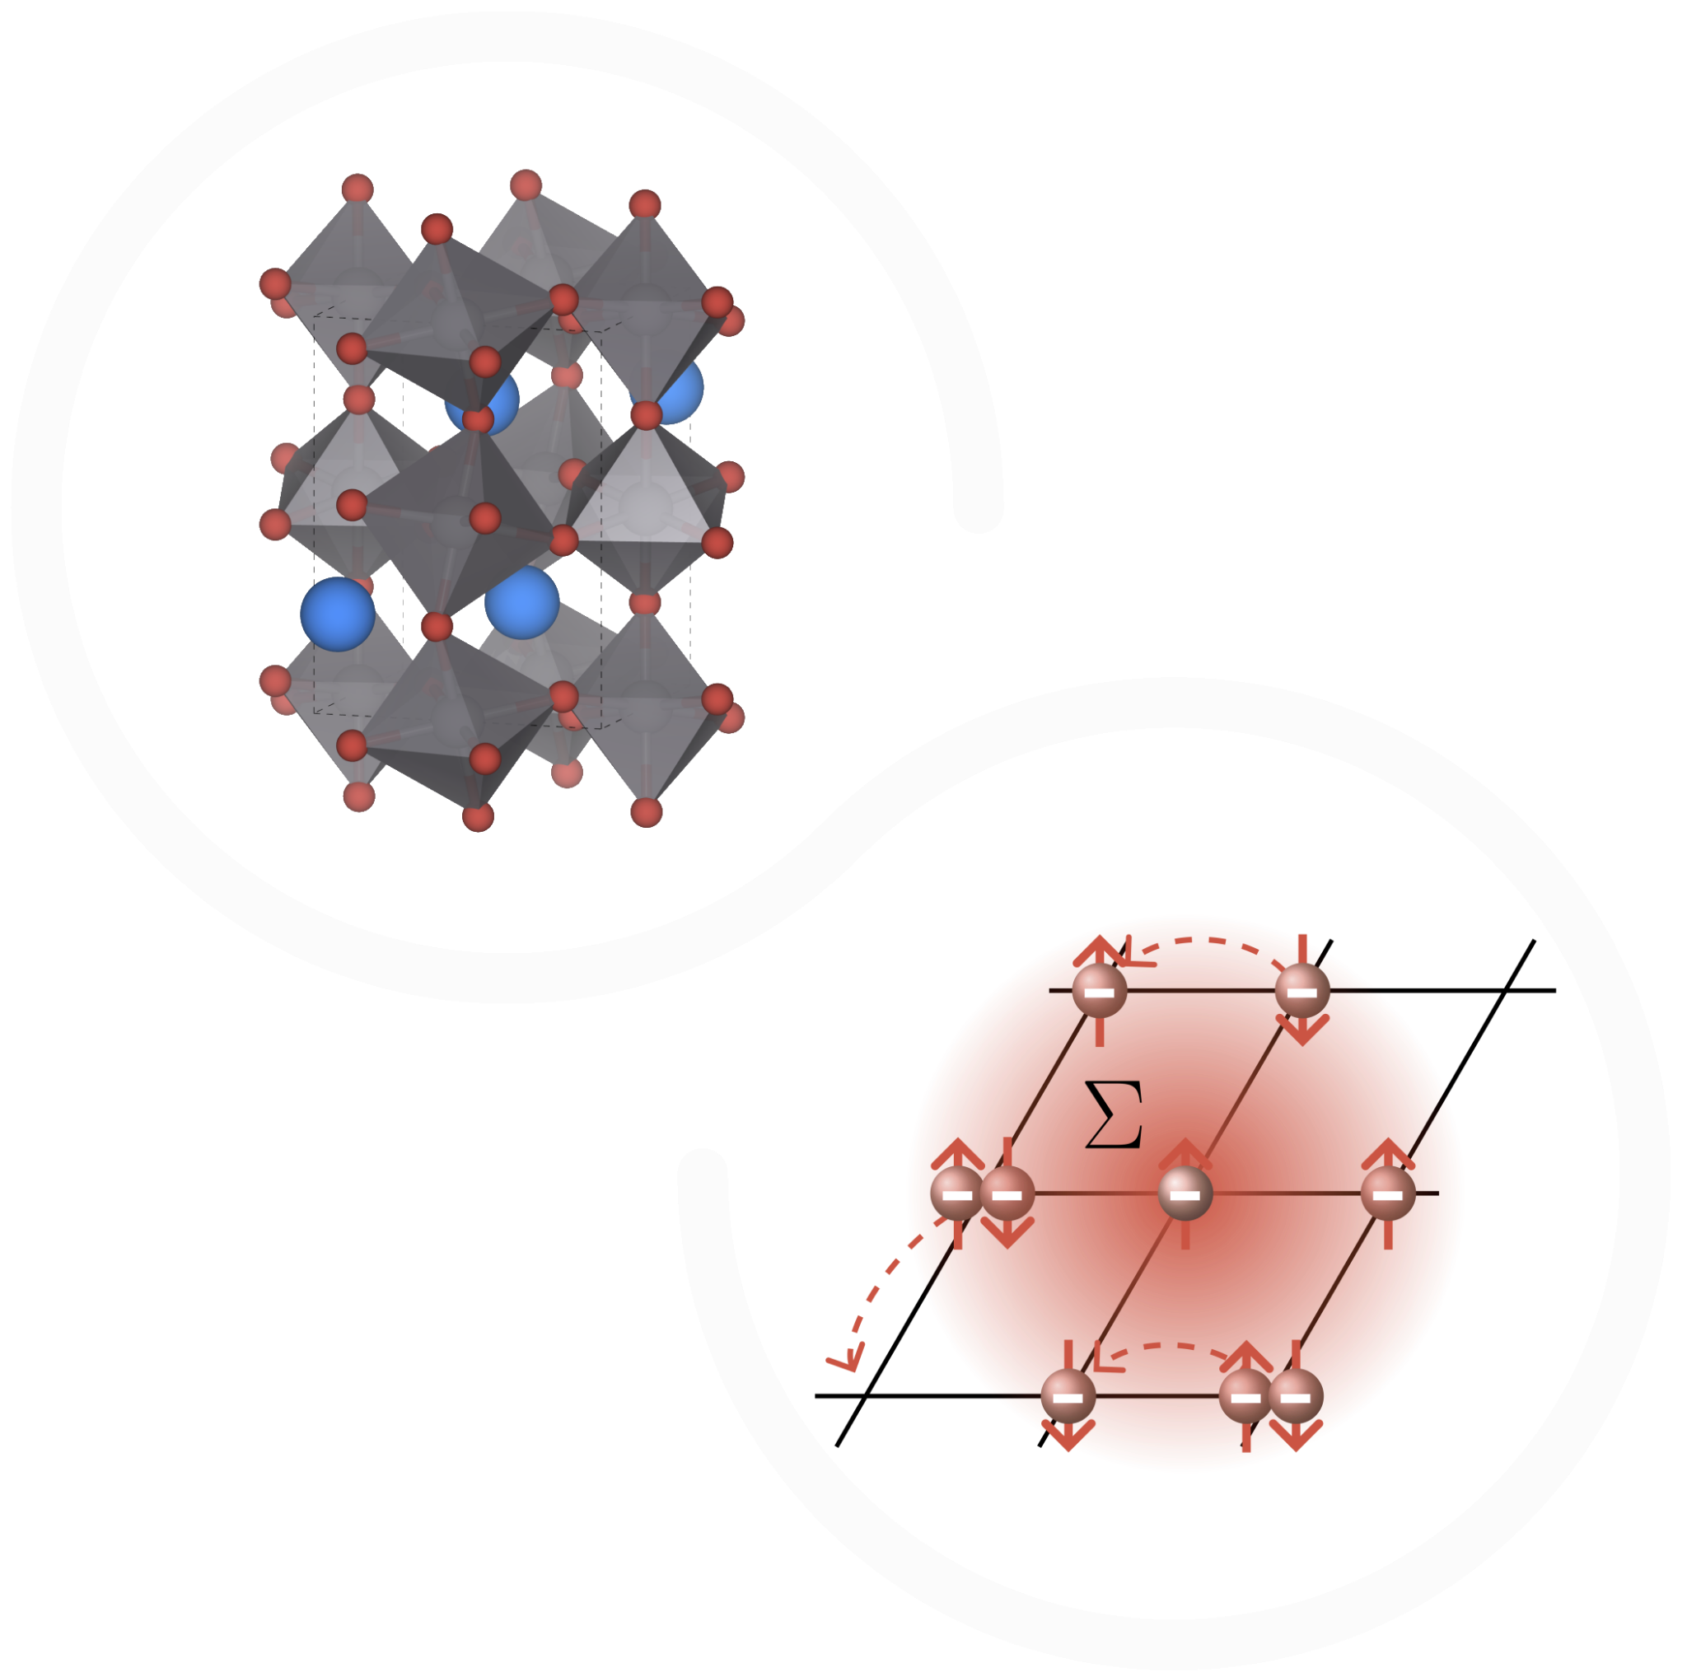
Going beyond DFT
BSE
GW
Useful for quantitative analysis of the band gap
Useful to study bound states (excitons) excitations and absorption spectra
…and in general all those techniques that go beyond DFT and are useful to study dynamical and out-of-the-ground-state properties:
QMC (Jonas Schwab, 084.9, 17:45 today), core-hole excitations, TDDFT…
DMFT
Useful to study metal-to-insulator (Mott) transitions

Slide 5
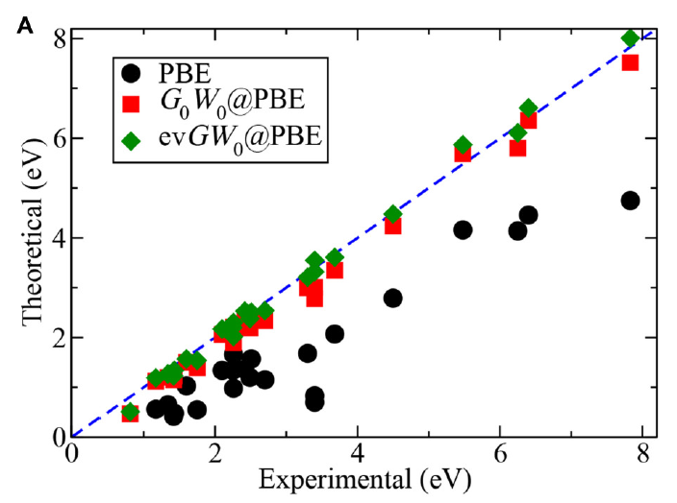
GW
Useful for quantitative analysis of band gaps
Band gap
Jiang et al., PRB 93 (2016)

Slide 6
GW workflows
Useful for quantitative analysis of band gaps
- Hedin cycle: G0W0, scGW…
- Analytical continuation - n_states
- dielectric
- k- and q-grid
- frequency
Input GW method
Input DFT method
GW
SinglePoint
Output GW states
DFT
SinglePoint
Output DFT states
Input structure

Slide 7
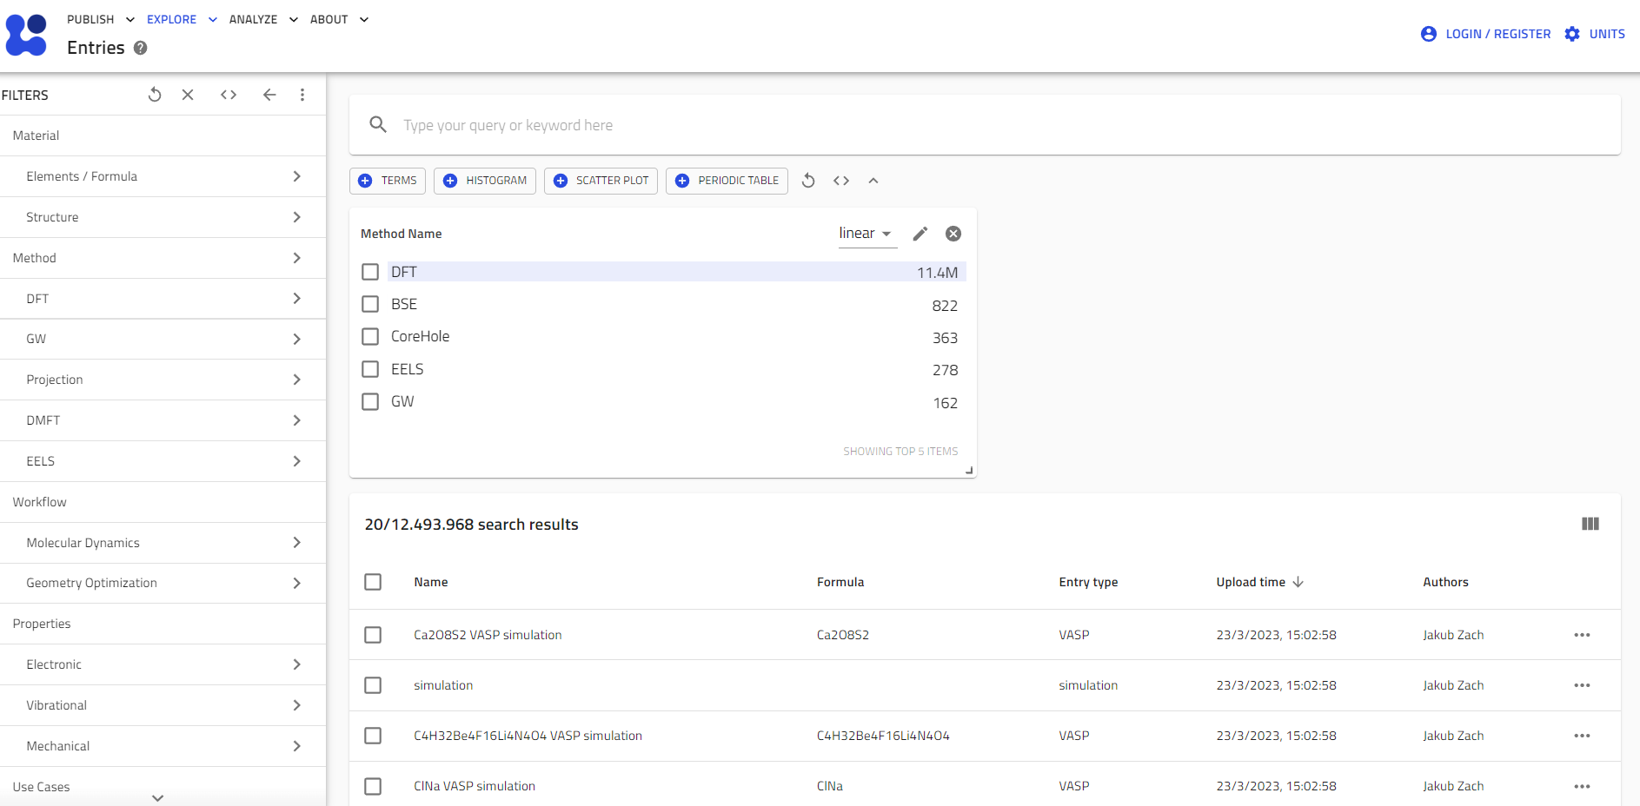
Making GW FAIR

Slide 8
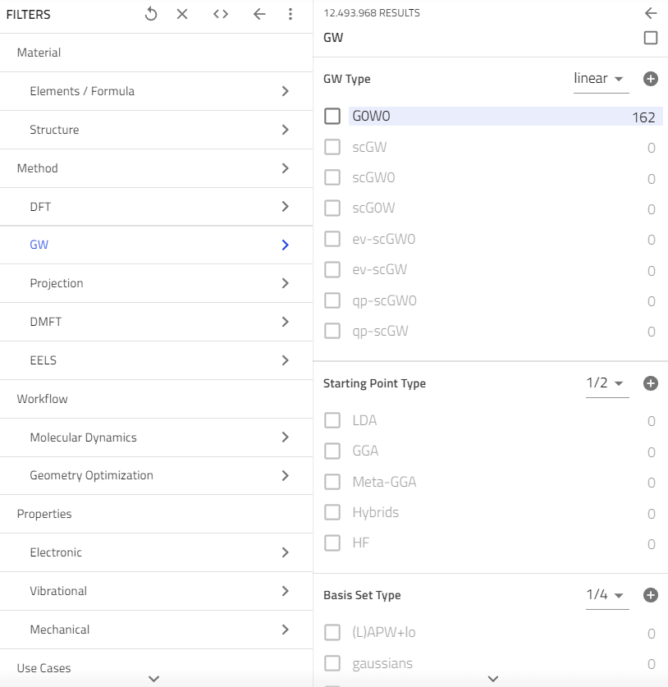
Making GW FAIR
Codes supported: exciting, FHI-aims, ABINIT, VASP
Re-processing of NOMAD will populate these.

Slide 9
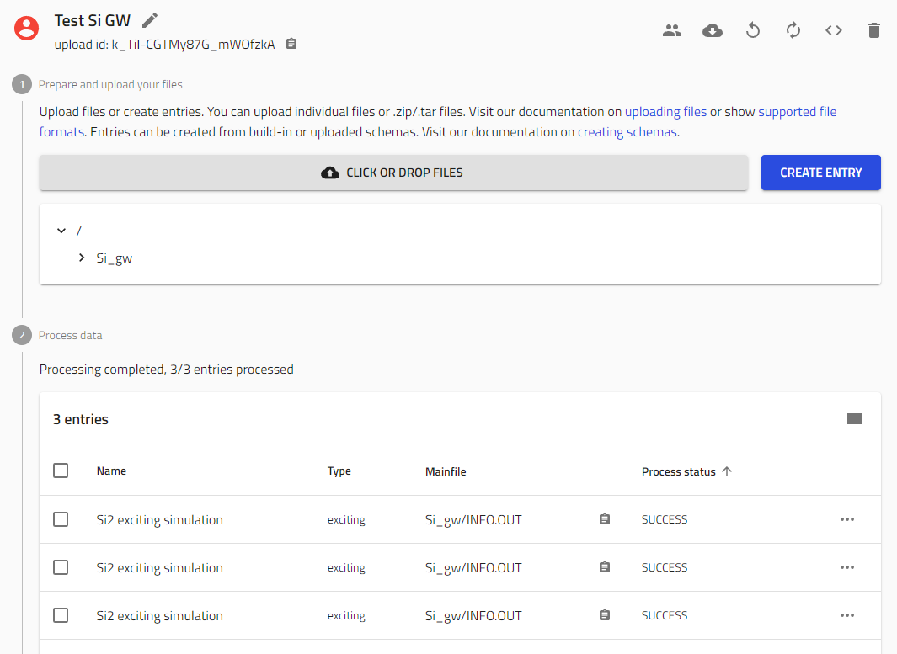
GW uploads
1- DFT entry (DFT SinglePoint)
2- GW entry (GW SinglePoint)
3- DFT+GW entry (GW workflow)

Slide 10
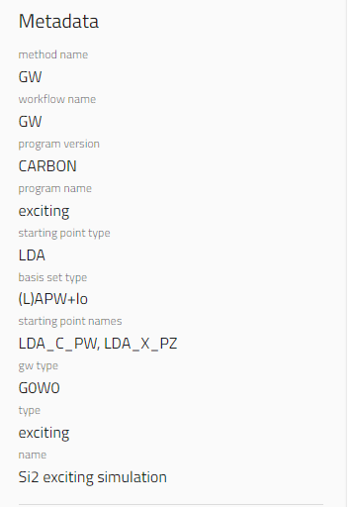
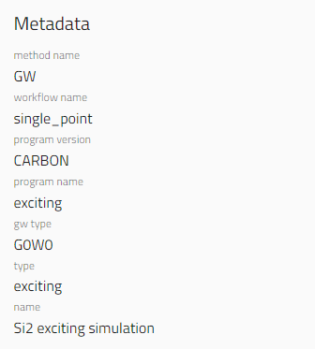
GW entries
GW SinglePoint
GW workflow

Slide 11
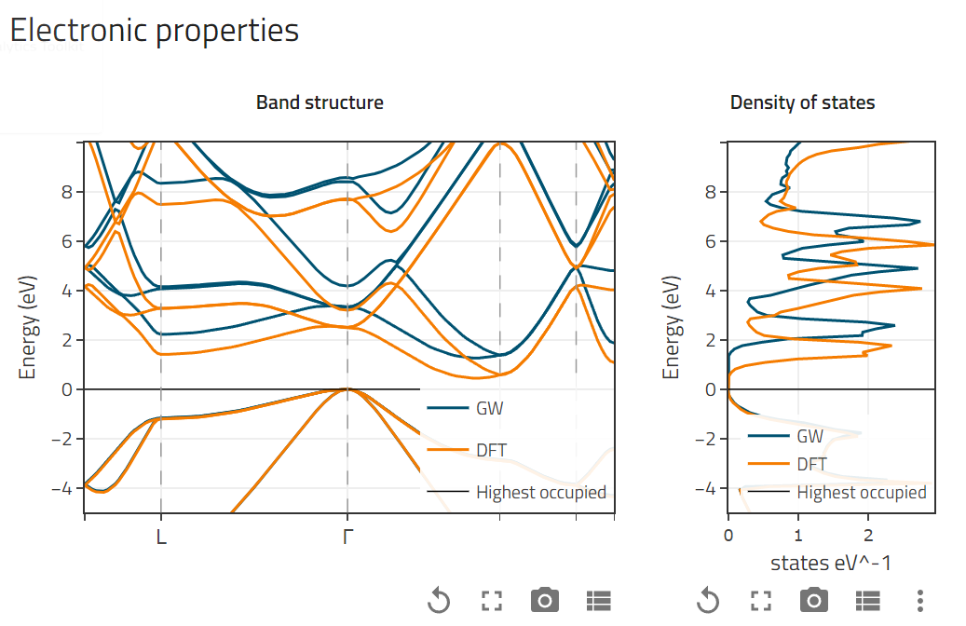
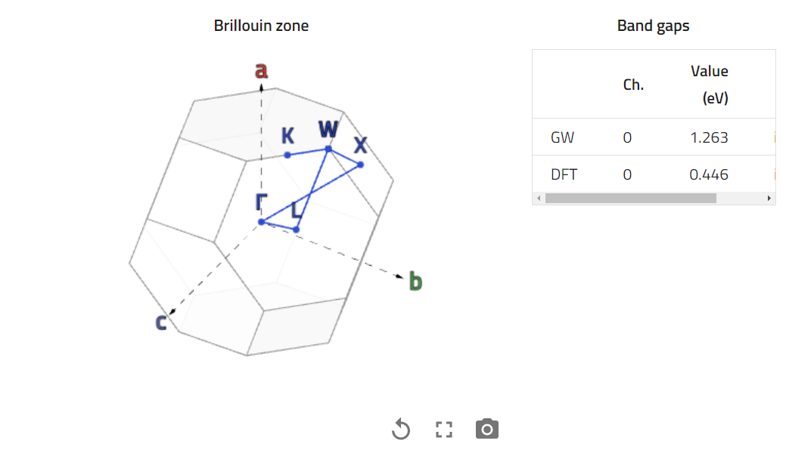
GW entries
Si2 - GW workflow

Slide 12
Going beyond DFT
BSE
GW
Useful for quantitative analysis of the band gap
Useful to study bound states (excitons) excitations and absorption spectra
…and in general all those techniques that go beyond DFT and are useful to study dynamical and out-of-the-ground-state properties:
Core-hole excitations, TDDFT…
DMFT
Useful to study metal-to-insulator (Mott) transitions

Slide 13
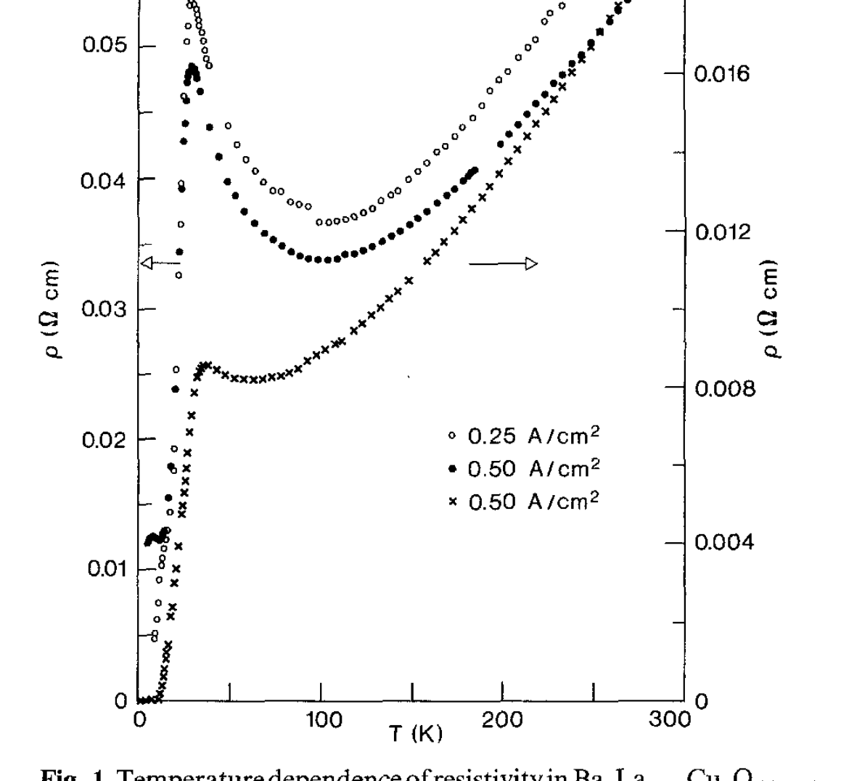
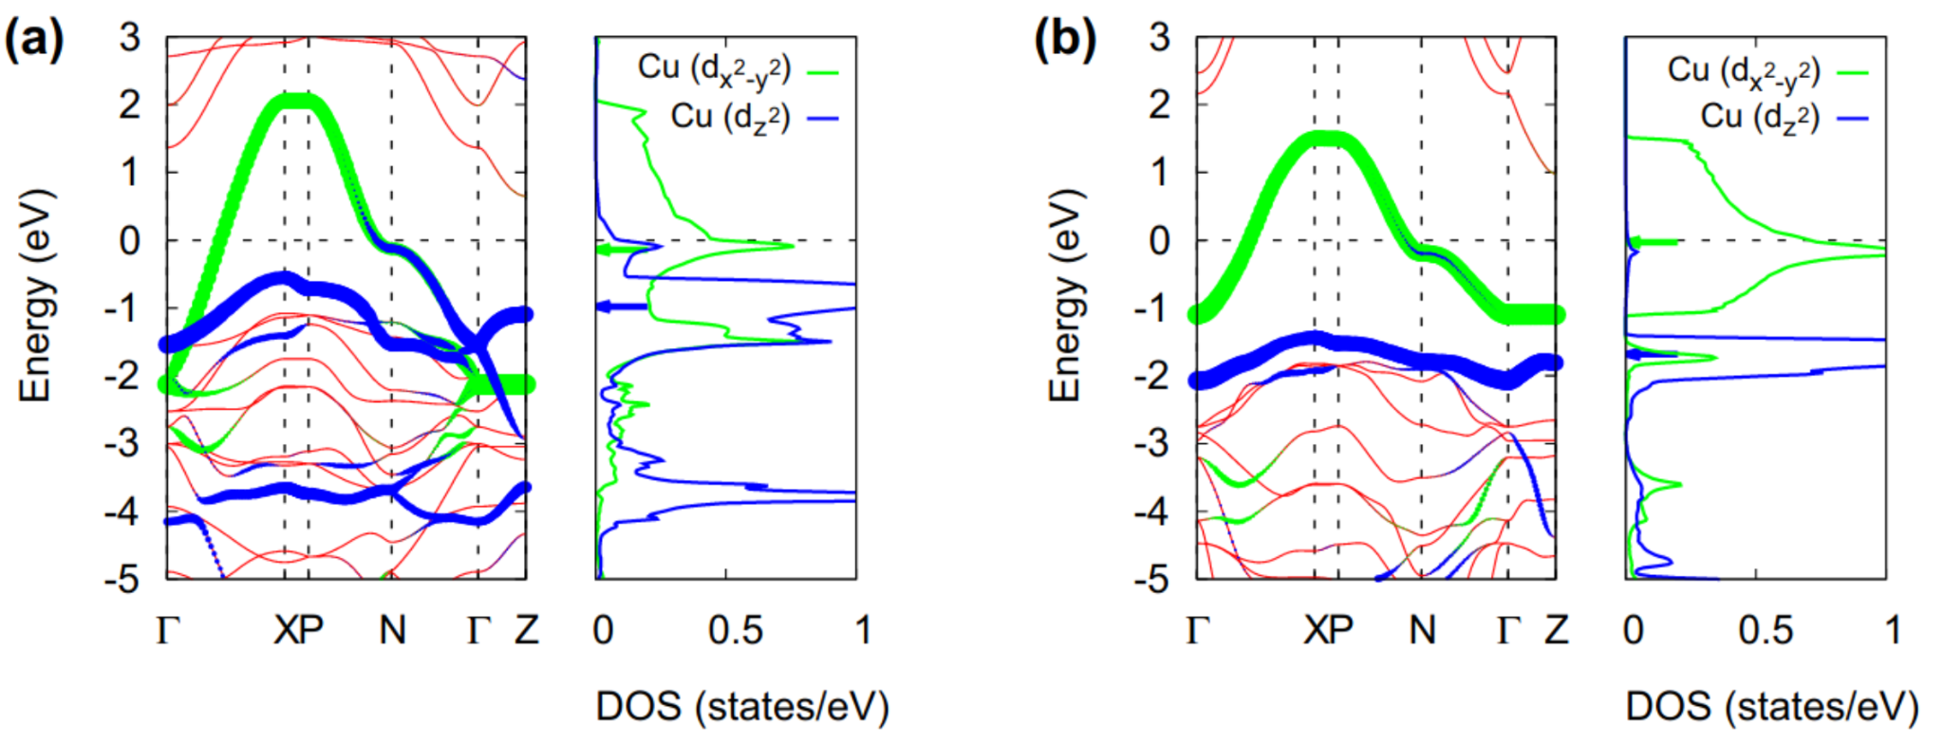
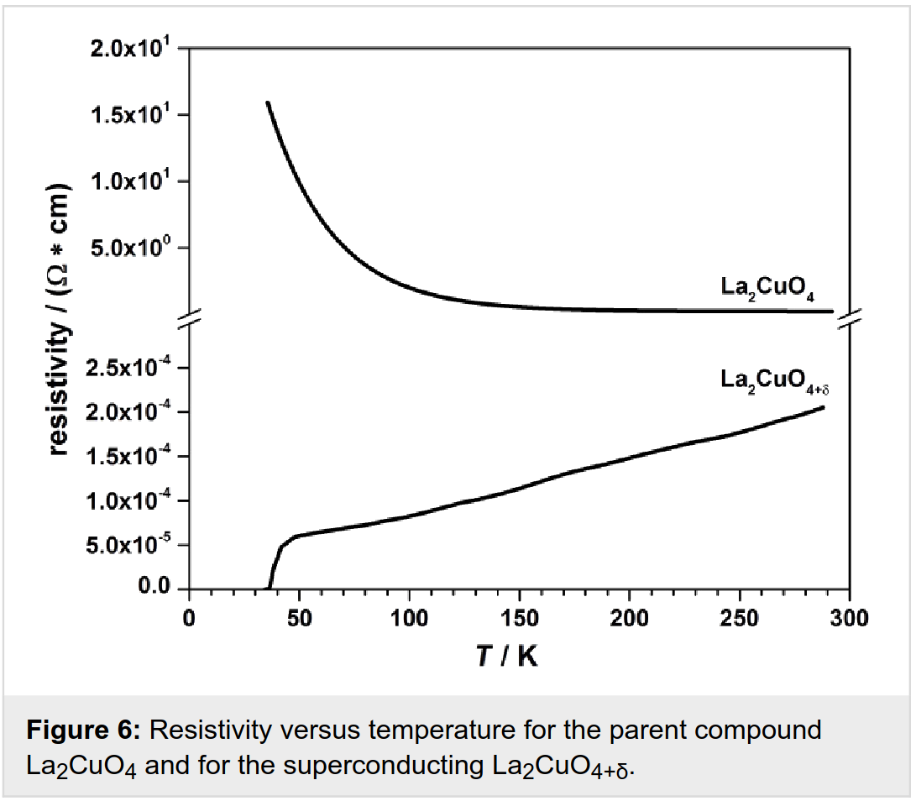
DMFT
Useful to study metal-to-insulator (Mott) transitions
cuprates
DFT
qpGW
Berdnorz and Müller, Zeitschrift für Physik B Condensed Matter 1986
Baiutti et al., Beilstein J. Nanotechnol. 2014
Woo Jang et al., Sci. Reports 2015

Slide 14
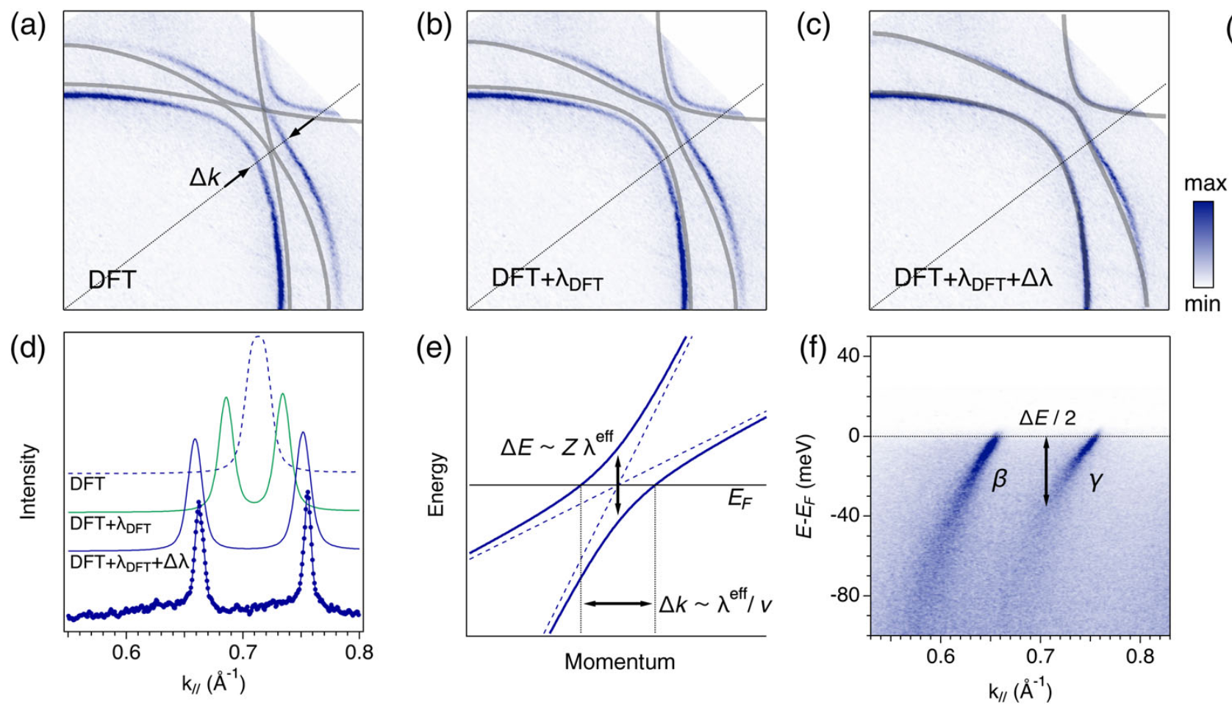
ARPES vs DFT + DMFT
Sr₂RuO₄
Tamai et al, PRX 2019

Slide 15
Making DMFT FAIR

Slide 16
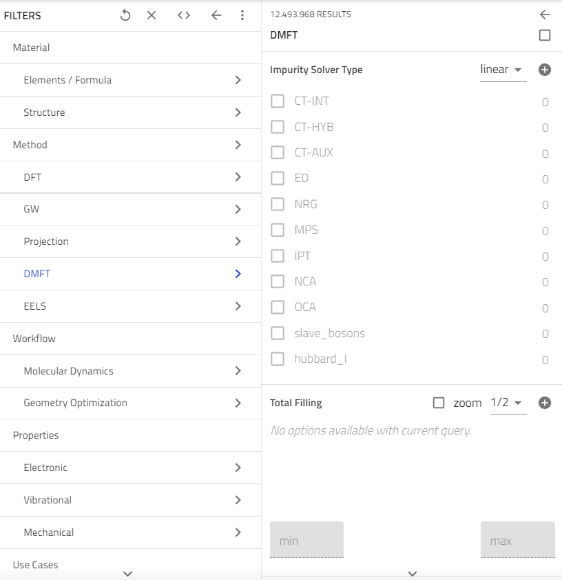
Making DMFT FAIR
Codes supported: w2dynamics, solid_dmft

Slide 17
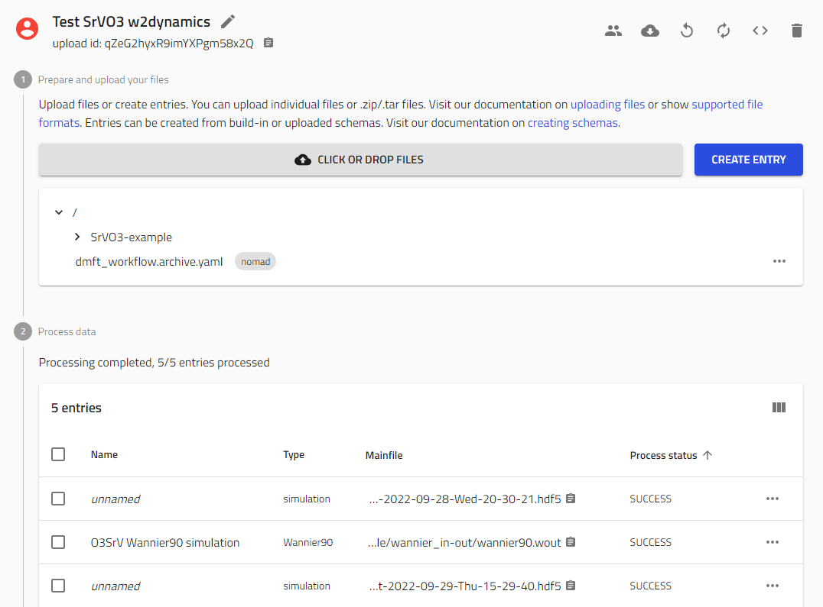
DMFT uploads

Slide 18
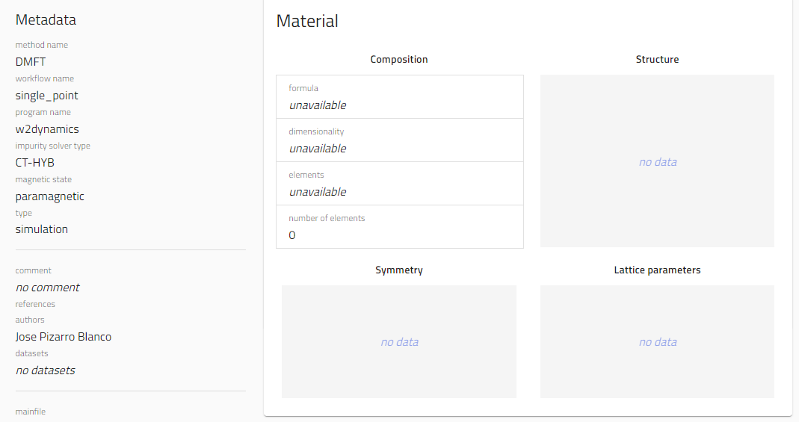
DMFT (small) issue

Slide 19
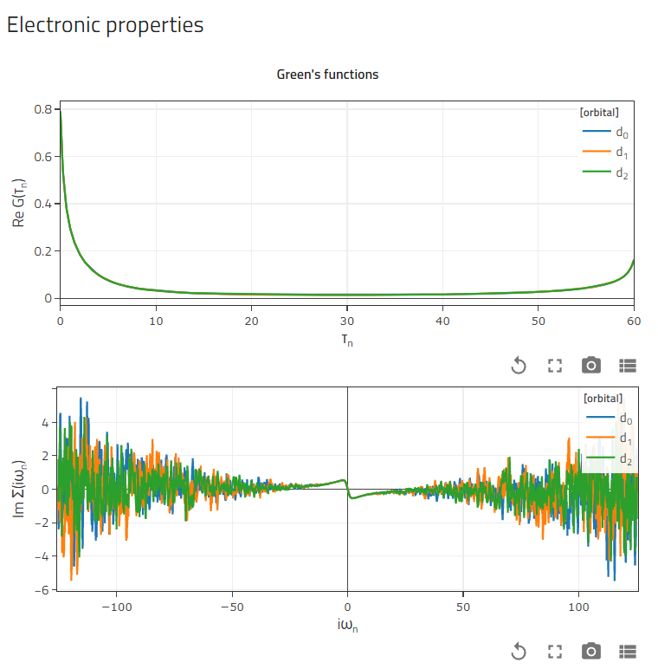
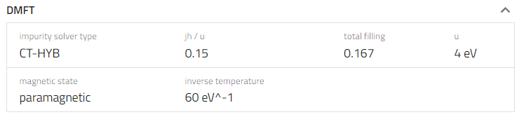
DMFT entries
SrVO3

Slide 20
DMFT workflows
Useful to study metal-to-insulator (Mott) transitions
- Impurity solver.
- Interactions (U, J).
- Temperature.
- Filling.
- k-grids.
- Freq/time grids.
- Type (Wannier, Slater-Koster).
- Atoms and projected orbitals.
- n_orbitals.
- k-grids.
Input DMFT method
DMFT
SinglePoint
Input Projection method
Output DMFT states
Input DFT method
Projection
SinglePoint
Output Projection states
DFT
SinglePoint
Output DFT states
Input structure

Slide 21
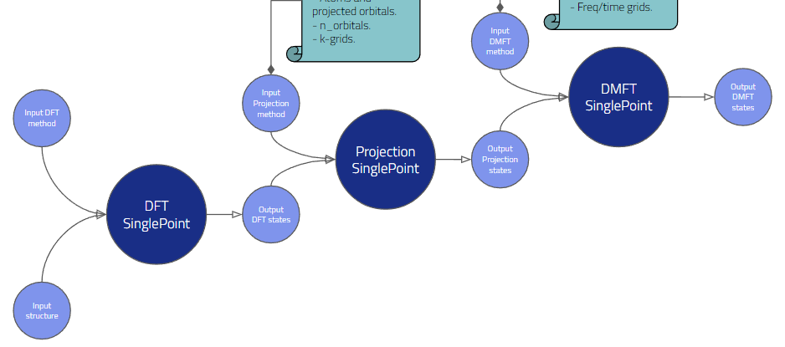
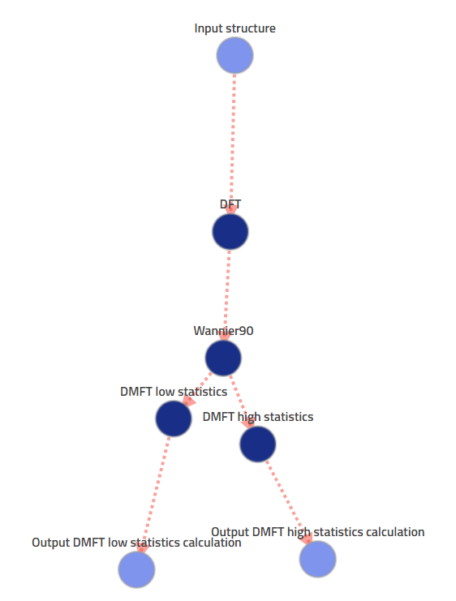
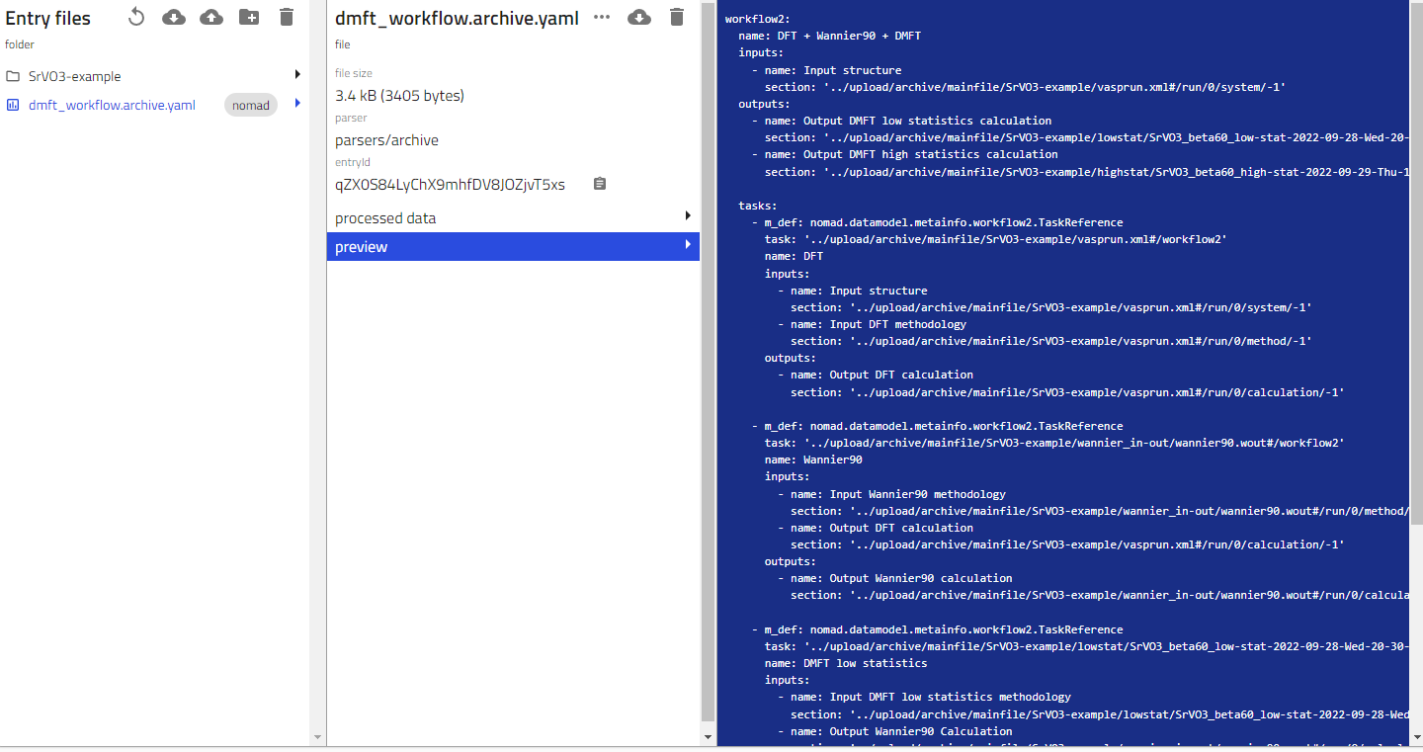
DMFT workflows

Slide 22
Goals and short-term objectives
Extend supported codes for GW, DMFT, BSE, CoreHole excitations.
Add more techniques metainfo: QMC, TDDFT…
Convince people to upload their data and give feedback.
Educate computational communities into Data Management.
Work on interoperability with Area B (materials characterization experiments): common metainfo, notebooks for analysis, etc.
Thank you for your attention!
jose.pizarro@physik.hu-berlin.de
@JosePizarroB (Twitter)

